Slide 1

Career Guidance Management System

Slide 2

Supervisor
Ms. Divya Singhal
Team Members
Akarsh Mishra (Team Leader)
Akanksha Mangal
Group No. GB02

Slide 3


Introduction :
Graduation marks the end of college, leaving many students uncertain about their future.
Choosing a career path, especially in fields like Engineering, can be challenging due to the multitude of options.
It's crucial for students to assess their capabilities and identify their interests while in college to clarify their career goals.
Proposed idea: ML-based "Career Guidance System" to assist students, especially in their pre-final and final years, in determining suitable job roles based on their performance and evaluations.

Slide 4
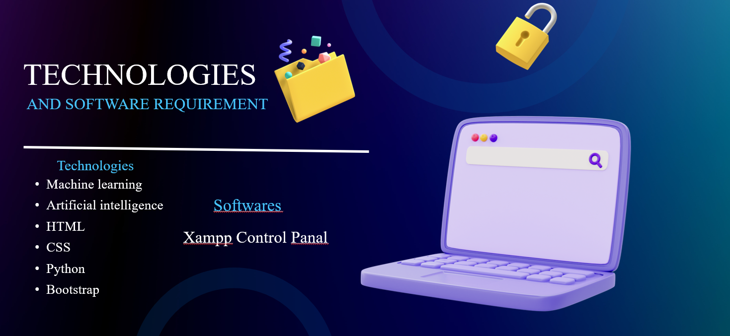

Slide 5

Hardware Requirements
Processor: Intel Core i5 or equivalent
RAM: Minimum 8GB
Storage: SSD
Network Interface: Gigabit Ethernet

Slide 6

Report Outcome
Clarity and Direction
Goal Achievement
Increased Opportunities
Professional Development
Improved Job Search Efficiency
Networking and Mentorship
Confidence and Empowerment

Slide 7

Conclusion
Clarity and Direction
Goal Achievement
Increased Opportunities
Professional Development
Improved Job Search Efficiency
Networking and Mentorship
Confidence and Empowerment

Slide 8

Thank you 😊

